Slide 1



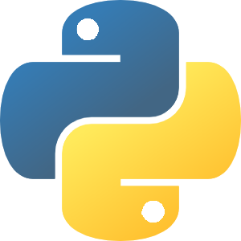

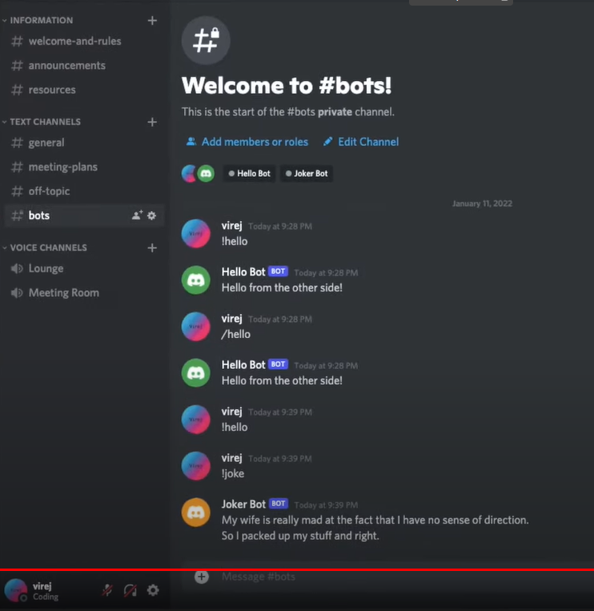
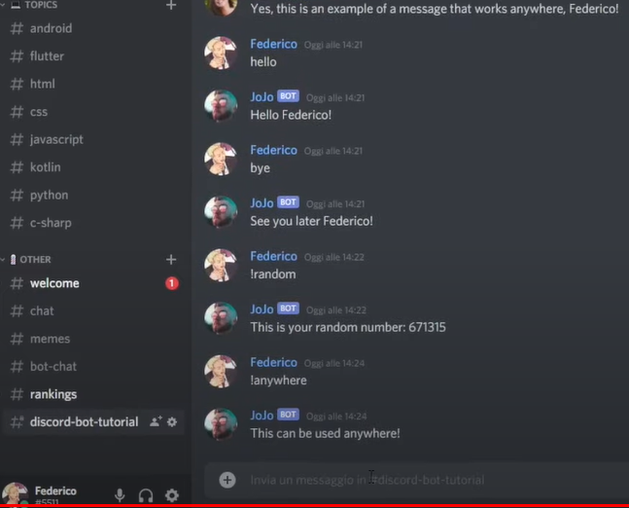
IS 3020 Spring 2022
Final Coding Project:
Presented by: Seth Holland
Discord Bot
Built with Python code
Built to automate key processes within Discord servers for a more organized, engaging and gratifying community experience!
Originally developed and inspired by GitHub users:
virejdasani & SamArroyos22

